Slide 1
Lesson 14:
Programming in Python

Slide 2
First let’s talk about questions I asked you to do in the previous class

Slide 3
What is an IP address?

Slide 4
IP Address Basics
An Internet Protocol address(IP address) provides an identity for a device connected to a network.
If we want to deliver a package to someone then we should know the exact address of the recipient. Similarly we should know the IP address of other device to communicate with that device.
Computer uses DNS servers to look up a hostname to find its IP address.
There are currently two version of Internet Protocol (IP): IPv4 and a new version called IPv6. One reason IPv6 is replacing IPv4 is that it can provide a much larger number of IP addresses than IPv4 allows.
The way IPv4 addresses are constructed means it's able to provide over 4 billion unique IP addresses (232). IPv6, on the other hand, supports a whopping 340 trillion, trillion, trillion addresses (2128). That's 340 with 12 zeros! This means every person on earth could connect billions of devices to the internet.

Slide 5
Let’s start understanding how google indexing and crawling works.

Slide 6
What will you do if you are asked to find the definition of certain term from a massive book? Naturally you would look at the back of the book where glossaries are given. Right?

Slide 7
How Google Search Results Work: Crawling, Indexing and Ranking

Slide 8
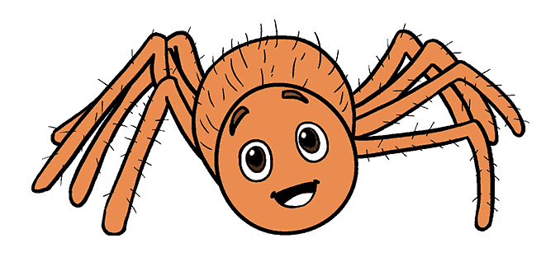
How Google Search Results Work: Crawling, Indexing and Ranking
Crawling Web Pages
Analyse page content
Store in the index
Ranking Algorithms

Slide 9
How Google Search Results Work: Crawling, Indexing and Ranking
Similarly, when we do a google search, we aren't actually searching a web. We are searching google indexes of the web. We do this with software programs called crawlers (aka spiders).
Google has crawlers (aka spiders) that “crawl” the World Wide Web to discover pages that exist in order to help identify the relevant web pages for the user.
Whenever crawlers look at a web page, they look through the “Document Object Model” (or “DOM”) of the page to see what’s on it.
The DOM is the rendered HTML and Javascript code of the page that the crawlers look through to find links to other pages. This allows the search engine to discover new pages on the web, and each of the new links they find are loaded in a queue which the crawler will visit at a later time.

Slide 10
How Google Search Results Work: Crawling, Indexing and Ranking
Spiders start by fetching a few web pages then they follow the links on those names and fetch the pages they point to, and follow all the links on those pages and fetch the pages they linked to and so on, until we've indexed a pretty big chunk of the web.
Suppose we want to search "West indies". Now google spider searches in the index of google to find every webpage that include those search terms. But now there will be millions of results available. Now how do google decides which document are really important.
Now there are many parameters for that. Like how many times does the searches document has the given keyword appear in title, URL or synonym of the word. Is this page from a quality website or a low grade spamming website. What is this page's pagerank. Finally we combine all those factors together to produce each page's overall score and send us back the search result.

Slide 11
HTTP - Hypertext Transfer Protocol

Slide 12
What is HTTP ?
HTTP (Hypertext Transfer Protocol) is the set of rules for transferring files (text, graphic images, sound, video, and other multimedia files) on the World Wide Web.
As soon as a user opens their Web browser, the user is indirectly making use of HTTP.
HTTP is an application protocol that runs on top of the TCP/IP suite of protocols (the foundation protocols for the Internet).

Slide 13
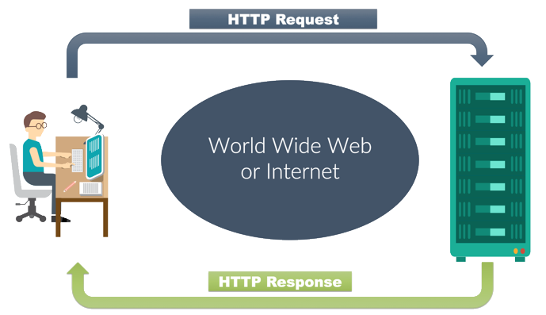
HTTP Requests

Slide 14
What is HTTP ?
When we send a HTTP request to a server in the form of a request message, which has the following parts:
Request method
Headers
Message body

Slide 15
Types of HTTP requests
Fetch an existing data
GET
Fetch an existing data without response body
HEAD
Create a new data
POST
Update an existing data
PUT
Delete an existing data
DELETE

Slide 16
Types of HTTP requests
A GET request retrieves data from a web server by specifying parameters in the URL portion of the request. This is the main method used for document retrieval
GET
The HEAD method is functionally similar to GET, except that the server replies with a response line and headers, but no response body.
HEAD
The POST method is used when you want to send some data to the server.
for example, file update, form data, etc.
POST
The PUT method replaces all current representations of the target resource with the request payload.
PUT
The DELETE method is used to request the server to delete a file at a location specified by the given URL.
DELETE

Slide 17
Introduction to GET.
GET request is for getting different data entities for example image, text, html page etc.
Basically, when you're typing a url in the web browser to access a web page, you are executing a GET Request.
A GET request has something called a query parameter. A query parameter is similar to the input that we provide a function which in turn returns a value.
Consider the following URL as an example: "facebook.com/profile.php?id=4" Here, id=4 is the query parameter.
A GET request can have 0 to n query parameters. First query parameter has ‘?’ in front of it. Any subsequent query parameters have ‘&’ separating them.
https://www.google.co.in/search?q=Python Let's replace value of q with some other programming languages.

Slide 18
Introducing Headers.
HTTP requests allow for extra information about the request as part of headers: like the IP address of the device, Operating System, Browser and similar information.
It is used to put location based restrictions on websites, just like how you cannot make an account on spotify as it is not accessible in India.
It is used to put restriction on specific content, just like how certain videos are restricted in some specified locations.
It is used to redirect the user based on their location, just like how amazon redirects you to amazon.in when you try to access amazon.com.

Slide 19
Introducing POST.
As we mentioned POST method is used for sending the data. This happens every time you fill up a form and press submit button or you like something on facebook or you send a chat message. All those actions are sent via POST to the server to record them in a database.
POST method contains a message body which is used to send data.
It has headers as well.
It can have query parameters but the convention is to not use them.

Slide 20
The TCP/IP Model

Slide 21
TCP/IP
TCP/IP stands for Transmission Control Protocol and Internet Protocol.
It is the network model used in the current Internet architecture as well.
Protocols are set of rules which govern every possible communication over a network. These protocols describe the movement of data between the source and destination or the internet.
Application Layer
TELNET
FTP
SMTP
DNS
Transport Layer
TCP
UDP
Internet Layer
IP
Network Layer
ARPANET
SATNET
LAN
Packet Radio

Slide 22
TCP/IP
Layer 1: Host-to-network Layer
Lowest layer of the all.
Protocol is used to connect to the host, so that the packets can be sent over it. Varies from host to host and network to network.
Layer 2: Internet layer
It is the layer which holds the whole architecture together.
It helps the packet to travel independently to the destination.
Order in which packets are received is different from the way they are sent.
IP (Internet Protocol) is used in this layer.
The various functions performed by the Internet Layer are:
Delivering IP packets
Performing routing
Avoiding congestion

Slide 23
TCP/IP
Layer 3: Transport Layer
Transport layer adds header information to the data.
Transport layer breaks the message (data) into small units so that they are handled more efficiently by the network layer.
Transport layer also arrange the packets to be sent, in sequence.

Slide 24
TCP/IP
Layer 4: Application Layer
The TCP/IP specifications described a lot of applications that were at the top of the protocol stack. Some of them were TELNET, FTP, SMTP, DNS etc.
TELNET is a two-way communication protocol which allows connecting to a remote machine and run applications on it.
FTP(File Transfer Protocol) is a protocol, that allows File transfer amongst computer users connected over a network. It is reliable, simple and efficient.
SMTP(Simple Mail Transport Protocol) is a protocol, which is used to transport electronic mail between a source and destination, directed via a route.
DNS(Domain Name Server) resolves an IP address into a textual address for Hosts connected over a network.

Slide 25
TCP/IP
TCP(Transmission Control Protocol)
It is a reliable connection-oriented protocol which handles byte-stream from source to destination without error and flow control.
TCP is suited for applications that require high reliability, and transmission time is relatively less critical.
TCP rearranges data packets in the order specified.
UDP(User-Datagram Protocol)
It is an unreliable connectionless protocol that do not want TCPs, sequencing and flow control.
UDP is suitable for applications that need fast, efficient transmission, such as games. UDP's stateless nature is also useful for servers that answer small queries from huge numbers of clients.
UDP has no inherent order as all packets are independent of each other.

Slide 26
We’ll continue in next class..
Any questions?

